Slide 1
Late-1800s Kitchen & Home Artifacts
Nodaway County Historical Society & Museum

Slide 2
Iron Cook Stove Presto Stove Polish
Circa 1850s, the Quick Meal stove was created by John Rigen, a German immigrant who lived in St. Louis, Missouri. These stoves were created for meal preparation and to heat water.
This polish was most likely used to shine up a stove. The polish could also be used to shine steel, iron, nickel, gold, silver, and several other metals. A can of polish sold for 25 cents in the late-1800s.

Slide 3
Griswold Cast Wagner Cast Iron Iron Skillet Skillet
Cast iron skillets were a part of most kitchens at the time and required special care. Their care included seasoning the skillet to prevent food from sticking. Due to this seasoning, these pans could not be washed with soap. Instead they were washed with salt and warm water.

Slide 4
Iron and Holder Vacuum
An early day vacuum sweep would clean up crumbs using wheels and bristles, rather than modern-day electricity.
An iron in the late-1800s was made out of cast iron, which was very heavy. Housewives would warm the iron with a fire and press the heavy piece of metal onto clothing.

Slide 5
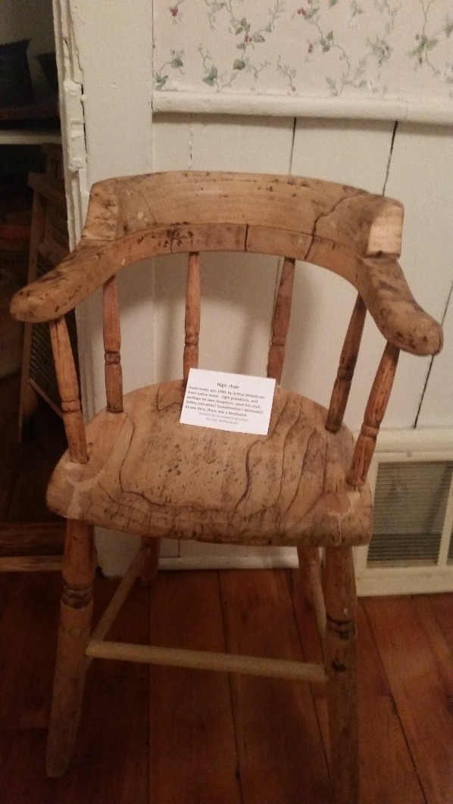
Butter Churners High Chair
This pre-1900 high chair was hand made out of natural wood. A dishtowel would be used as a restraint to keep the child from falling out of the chair.
In the late-1800s you could not buy butter at the store, so women would go through the time-consuming process of making homemade butter.

Slide 6
Carpet Beater Washboard
Washboards were used instead of the washers and dryers we have today. Women would lay a washboard in a bucket of soapy water and run clothing along the rivets to scrub the clothes.
A carpet beater was a housecleaning tool that was in common use until the vacuum cleaner was invented and became affordable. Carpets were hung on a railing and dust/dirt was beaten out of them with the carpet beater. It was hard work!

Slide 7
Millstone Water Pump
Hand pumps are manually operated pumps that were used to move water from an underground well to a bucket. This bucket could then be taken inside the house to use for cooking and cleaning in the kitchen.
In the late-1800s, you couldn’t go to the store and buy bread. Millstones were stones used to grind wheat or other grains to make bread. Look for the one at the museum; there is another on the Northwest campus!

