Slide 1
Gender Roles in Society
Background knowledge
Lesson for grades 4-6

Slide 2
Social Change
Social change refers to the adjustment in the social order of society.
Social change affects several different parts of a society, including changes in nature, foundations, behaviors, and relations.
Student led discussion: Think about different issues we, as a society, have had in the past. Now think about how those issues have changed since time has passed.

Slide 3
Gender Roles
Gender roles refer to a set of societal norms dictating what types of behaviors are generally considered acceptable, appropriate, or desirable for a person based on their actual or perceived gender.

Slide 4
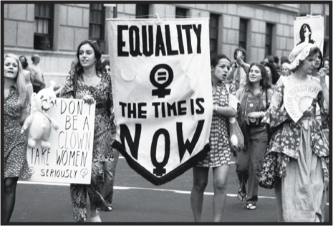
Women’s Roles
Student led discussion: Think about the varying roles that women have taken on throughout history.
Women roles were often based on what was happening during that specific time in history and what the societal norms were.
These changes in society can be seen throughout the Nodaway County museum and the different women included in the various exhibits.

Slide 5
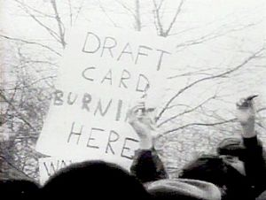
Men’s Roles
Student led discussion: Think about the varying roles that men have taken on throughout history.
Form the 1940s to the 1970s, men were being drafted into war. The fear of being drafted was something that hung over many young men’s shoulders.
Through the Nodaway County museum’s military displays, students can see the different roles men played during times of war.

Slide 6
Societal Changes & Gender Roles
Changes in society and the way people think changes gender roles. It is obvious that the roles each gender takes varies depending on societal norms.
When discussing the difference in gender roles, it is important to note how societal norms have changed and how that affects gender roles in our culture.

